Slide 1
Minimizing Transaction Latency in Geo-replicated Data Stores
Divy Agrawal
Department of Computer Science
University of California at Santa Barbara
Joint work with: Amr El Abbadi, Hatem Mahmoud, Faisal Nawab, and Vaibhav Arora
Notes:
We are in the era of big data and large-scale systems.
The issue of performance become paramount in that we want these systems to be scalable, fault-tolerant, and exhibit low latency.
Scalability to a larger extent especially in the context of datacenters is being addressed at multiple levels:
innovative software-based approaches have been developed for very high scalability by leveraging thousands of machines in the data center.
In the same vein, rapid hardware advances have also made the problem of scalability relatively easer.
In the context of fault-tolerance, failures within the datacenters can be handled by storage disaggregation and storage redundancy.
However, datacenter failures remain a major vulnerability which can only be overcome by wide-area replication over multiple datacenters.
But wide-area replication becomes a source of latency bottlenecks.
My presentation will debunk the scalability issues and instead focus on the latency problem in the context of geo-replicated data over multiple datacenters in a systematic manner.

Slide 2
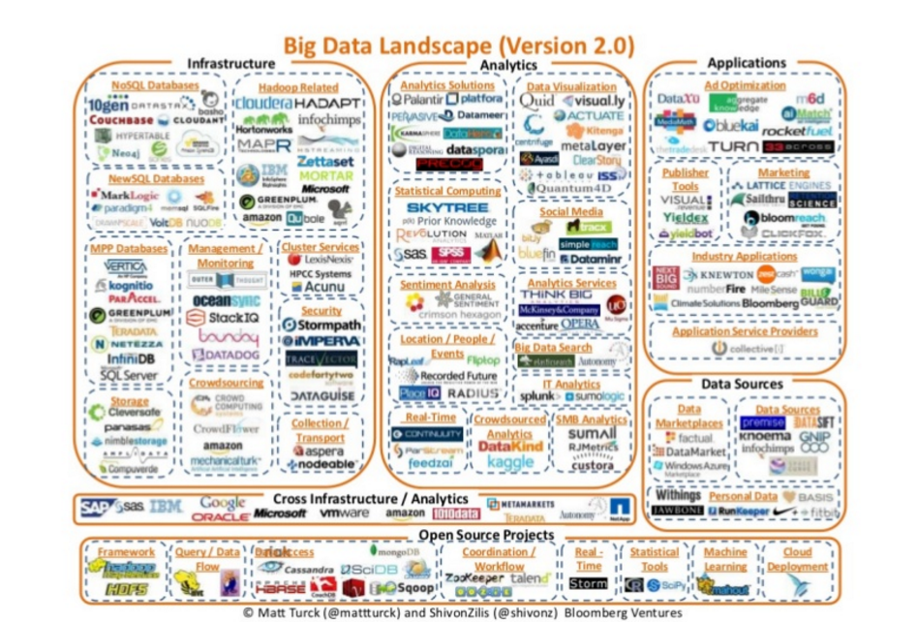
Motivation
Cloud computing and big data infrastructures:
Move away from traditional database solutions.
Infrastructure technologies: Bigtable (for data management), and MapReduce (for data analysis).
Last decade: proliferation of numerous solutions.

Slide 3
Data-centric Synchronization: A Renaissance
Low-level Storage Architectures:
Eventual consistency ➔ higher-level guarantees
Reason: Lack of clear semantics ➔ source of confusion to developers
Data Store Architectures:
Single row atomicity ➔ multi-row transactional guarantees
Reason: Primitive data API ➔ Proliferation of duplicate code
Data Replication:
Non-zero failure probabilities ➔ Multi-datacenter architectures (fault-tolerance)
Datacenter migration ➔ Multi-datacenter solutions (availability)

Slide 4
Data-centric Synchronization: A Renaissance
Low-level Storage Architectures:
Eventual consistency ➔ higher-level guarantees
Lack of clear semantics ➔ source of confusion to developers
Data Store Architecture:
Single row atomicity ➔ multi-row transactional guarantees
Primitive data API ➔ Proliferation of duplicate code
Data Replication:
Non-zero failure probabilities ➔ Multi-datacenter architectures (fault-tolerance)
Datacenter migration ➔ Multi-datacenter solutions (availability)

Slide 5
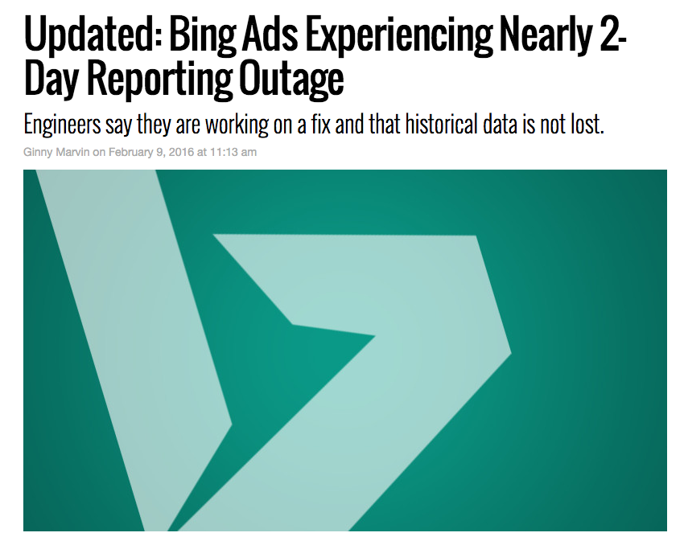
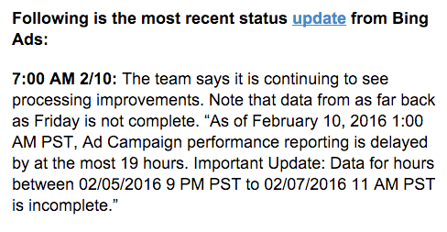

Slide 6
Multi-datacenter Architectures
A
B
C
A
Datacenter California
B
C
Datacenter Virginia
A
B
Localized access
Fault-tolerance
Planned Outages
C
Datacenter Oregon
Notes:
The idea behind geo-replication is to take your application or data and copy it to another location.
So, for example, if your application and data are in datacenter california, you might want to have copies of them in a datacenter in Virginia and Oregon.
This way you are closer to users in Virginia and Oregon.
More importantly, if the datacenter in oregon experienced an outage, the application can still serve requests from the other datacenter.

Slide 7
Multi-datacenter Synchronization
Wide-area latency
Coordination is expensive
Consistency guarantees
Transaction support
Focus on cross-datacenter messages
Notes:
The main difference in geo-replication is that the communication latency between replicas is very large.
The wide-area latency can be in the order of 10s to 100s of ms.
This large wide-area latency makes coordination very expensive
Coordination is specially needed for database transactions with strong guarantees.

Slide 8
Spanner [OSDI’12]
2PC/PAXOS

Slide 9
Spanner [OSDI’12]
Google’s solution for multi-datacenter replication
Each partition has a leader
Read operations are synchronized (locked) at Paxos Master copy
Writes are deferred.
Commit protocol (2PC/Paxos)
Two-Phase Commit (2PC) across partition leaders
Paxos to replicate each step of 2PC
A
B
A
B
C
C

Slide 10
Optimistic variant: F1 on Spanner
Transaction Execution:
Optimistic reads
Deferred writes
At commit:
Validate reads (using timestamps)
Obtain read and write locks at the master
Spanner commit: 2PC/Paxos

Slide 11
Transaction latency
Read requests
2PC message
Paxos message
A
B
A
B
C
C
Datacenter California
Datacenter Virginia
Read (2)
Send prepare (1)
Replicate (2)
Receive prepare (1)
Replicate (2)
Commit (0)

Slide 12
Effective multi-datacenter replication
Spanner: An effective approach for multi-datacenter operations
(Acceptable) throughput?
Fault-tolerance
Transactional consistency: multi-objects + replication
Major challenge with geo-replication:
Wide-area communication delays ➔ adversely impacts latency budgets for interactive transactions (e.g., mobile E-commerce)
➔ Engineered solutions (leverage datacenter proximity)

Slide 13
Replicated Commit [VLDB’13]
PAXOS/2PC

Slide 14
Wide-area latency awareness
Inter-datacenter latency is much higher than intra-datacenter latency
Intra-datacenter latency: ~ 1-2 milliseconds
Inter-datacenter latency: 10s to 100s milliseconds
Minimize cross-datacenter communication
Replicated Commit [VLDB’13: UCSB]
Majority voting algorithm for the geo-replication framework
Metaphor: “Datacenter as a computer” paradigm

Slide 15
Replicated Commit
Transaction execution:
Read operations synchronized (locking) at majority data-centers.
Write operations deferred until commit.
At commit:
User application initiates a Paxos protocol
One of the shards at each data-center acts as a 2PC coordinator
2PC within each datacenter (prepare phase of 2PC is the voting phase of Paxos)
Commit phase of 2PC is integrated with the accept phase of Paxos

Slide 16
Replicated Commit [VLDB’13]
Read requests
Voting messages
Locking messages
A
B
B
A
C
C
Datacenter California
Datacenter Virginia
Read (2)
Voting request (1)
Locks (0)
Voting (1)
Commit (0)

Slide 17
Latency Analysis
Latency depends on the network topology
Read phase
Replicated commit: majority (subject to stragglers)
Spanner: read from the leader
Commit phase
Replicated commit: 1 round to majority (2)
Spanner: 1 round to leaders (2) + majority round from leaders (4)

Slide 18
Performance (Amazon Datacenters)
Five data centers
Data into 3 partitions
YCSB clients at each data center
Average commit latency (ms)
403
167
337
92
Replicated Commit
2PC/Paxos
NOTE: Our implementation
Notes:
Display the commit latency results, showing that the latencies are according to what we expect.
0) we performed an evaluation on Amazon EC2. five data centers, three partitions.
We view a sample of the results for two data centers.
The green circles denote the response latency for replicated commit, and the red circles denotes it for spanner
Virginia, then Ireland

Slide 19
Request-Response Paradigm ➔ RTT Barrier

Slide 20
Datacenter A
Datacenter B

Slide 21
Latency
Datacenter A
Datacenter B

Slide 22
Message LogGING [CIDR’13]

Slide 23
Event Log Propagation
Message Futures [CIDR’13]
Leverages event logs and log propagation that ensures causality [FiMi82,Wuu84,Liskov86,…]
Decouples consistency and fault-tolerance
Protocols to ensure consistency only
Augment with fault-tolerance [skipped]

Slide 24
Message Futures
Simple case: Ping ponging log propagations
Commit rule: (1) wait until next log is received
(2) detect conflicts with coming log.
A
txn
Commit
Latency less than RTT
B
Notes:
This is a simpler version of message futures (to make the idea easier to understand). In this version, the log propagation pattern is constrained in the following way: only one log transmission is being propagated at any time. When a machine receives a log, it sends a log, mimicking a ping-ponging pattern.
The animation focuses on the scenario with two replicas. And a txn (in orange circle) that we want to commit. The claim is that we can commit once we receive a log with the commit rule in the slide. The commit rule leads to detection of all conflicts because any transaction txn2 in B that conflicts with txn will either lead to txn aborting or txn2 aborting.
- if txn2 is in the red region, txn will detect it in the log, and txn will abort.
- If txn2 is in the purple region, it will detect txn and txn2 will abort.
- If txn2 is in the yellow region, it has started after txn has been received at B and thus either detects the conflict or txn2 reads from txn.
Main take-away: we can commit transactions (for consistency without fault-tolerance) with less than RTT latency.

Slide 25
Arbitrary Propagation Rates
General case: Continuous log propagations
Commit rule: (1) wait until previous log transmission is acknowledged
(2) detect conflicts with coming log
A
txn
txn
Commit
B
Notes:
The real Message Futures does arbitrary log propagation.
Commit rule changes to reflect the propagation.
Animation shows that txn can commit with commit rule by showing that a txn2 at B will either detect txn or vice versa (analogous to previous slide)

Slide 26
“Is there a lower-bound
on transaction latency?”
[SIGMOD’15]
Notes:
Now that we broke the RTT barrier, what is the limit?

Slide 27
T1 requests to commit
T1 commits
A
T1 latency
T2 latency
B
Events can affect outcome of T1
Events can be affected by T1
Transaction T2
What is the relationship between the latencies
of transaction T1 and T2?
Notes:
This illustrates the lower bound by dividing regions in B according to a transaction T1 in A. The red region is where events at B might affect T1’s outcome (before its commitment). The green region is where events at B are affected by T1 (after hearing about it). This leaves the white region where events at B do not affect T1 and are not affected by T1. Thus, a transaction that begins and commits at the white region T2 might lead to an inconsistency. This is because T1 and T2 committed without being aware of each other.
The relative latencies of T1 and T2 can be calculated from the (information) timelines. And they yield that Latency at A + latency at B must be at least the RTT between them.

Slide 28
A
c(T)
q(T)
T latency
B
Influence
Critical Zone:
T’ latency
Awareness
L[T] = c(T) – q(T)
Awareness zone > q(T) + RTT/2
Influence zone < c(T) – RTT/2
Critical zone: Awareness Zone – Influence Zone = RTT - L_{A}
Duration of the critical zone: RTT – L_{A}
But that is the latency of T’ at B, i.e., L_{B} > RTT – L_{A}
Equivalently: L_{A} + L_{B} > RTT

Slide 29
Optimal latency
Lower bound:
Latency(x) + Latency(y) > RTT(x,y)
A
30
20
B
C
40
Minimize (sum of latencies)
Subject to (1) Latency(A) + Latency (B) > RTT(A,B), for all A,B
(2) Latency (A) >= 0, for all A
Notes:
This the lower-bound more formally.
A graph of replicas to illustrate that the lower-bound must apply to all pairs.
With the lower-bound we can calculate what is the minimum average latency achievable using a minimization.

Slide 30
Optimal latency
A
30
20
B
C
40
Protocol | Latency(A) | Latency(B) | Latency(C) | Average
Leader-based (Leader A) | 0 | 30 | 20 | 16.67
Leader-based (Leader C) | 20 | 40 | 0 | 20
Majority | 20 | 30 | 20 | 23.33
Optimal | 5 | 25 | 15 | 15
Notes:
Example of optimal compared to other approaches.

Slide 31
Lower-bound result: What is the point?
What is the significance of this result – especially since we have no control of the physical reality (RTTs)?
No physical system can guarantee pre-determined values of RTTs between datacenters, right?
What happens when message communication is subject to random aberrations, e.g., lost messages?
Does this approach require perfect clock synchronization?

Slide 32
Philosophy of the Design
Use the physical reality (i.e., RTTs) to develop the right abstraction.
Physical RTTs ➔ Logical Notion of RTTs
Develop a protocol in the transformed domain to ensure that the resulting protocol guarantees correctness.
Deployment in the physical world should only impact efficiency not correctness.
Proximity of the physical reality to the logical abstraction will yield the desired result, i.e., optimal latency.

Slide 33
Achieving the lower-bound
[SIGMOD’15]

Slide 34
Helios: The Logical
A
Protocol | L_{A} | L_{B} | L_{C} | Average
Optimal | 5 | 25 | 15 | 15
30
20
B
C
40
A
100
105
B
90
115
C
95
110

Slide 35
Impact of the Physical Reality: RTT
What happens when:
RTT_{real} ≠ RTT
Does this jeopardize correctness?
The answer is NO.
RTT_{real} > RTT:
The commit latency realized at Datacenter A will be larger than what was expected.
RTT_{real} < RTT:
The commit latency realized at Datacenter A will be smaller than what was expected.

Slide 36
RTT_{real} > RTT
A
40
Protocol | L_{A} | L_{B} | L_{C} | Average
Optimal | 5 | 25 | 15 | 15
30
20
B
C
40
A
100
105
110
B
90
115
120
C
95
110
Notes:
Scenario: RTT between A and B becomes 40 (RTT_real) rather than 30 (RTT_estimate).
The transaction that starts at time 100 at A calculates that it needs to wait until it gets knowledge of B until time 90. But, because RTT is larger, this information is received at time 110, rather than time 105, which is the original case.

Slide 37
RTT_{real} < RTT
A
20
Protocol | L_{A} | L_{B} | L_{C} | Average
Optimal | 5 | 25 | 15 | 15
30
20
B
C
40
A
100
105
B
110
115
90
C
95
110
Notes:
Scenario: RTT between A and B becomes 20 (RTT_real) rather than 30 (RTT_estimate).
The transaction that starts at time 100 at A calculates that it needs to wait until it gets knowledge of B until time 90. But, because RTT is smaller, this information is received at time 100, rather than time 105, which is the original case. This means, that A gets what it needs from B when the transaction starts! If the same is true with C, then A could commit immediately.

Slide 38
Impact of Physical Reality: Clock skews
What happens when Datacenters clocks are not perfectly synchronized?
Correctness is preserved.
If a Datacenter A’s clock drifts ahead of others
The commit latency at Datacenter A will be larger than what was expected.
If a Datacenter A’s clock drifts behind others
The commit latency at Datacenter A will be smaller than what was expected

Slide 39
Performance Evaluation in A MULTI-Datacenter Environment

Slide 40
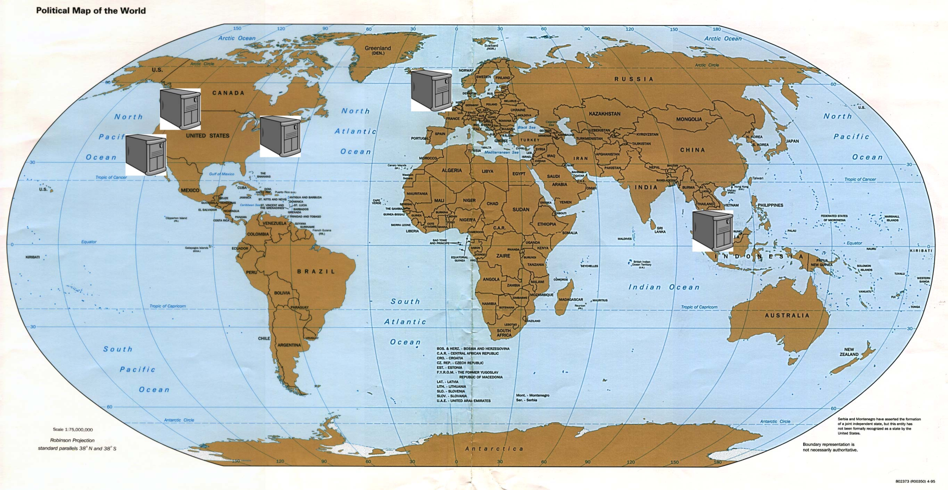
Performance Evaluation: Latency
Helios
Helios
Fault-tolerance
f = 2
Replicated
Commit
2PC/Paxos
211ms
221ms
167ms
58ms
226ms
107ms
110ms
Average
217ms
132
152
131
235
43%
35%
44%

Slide 41
Concluding Remarks
Protocol design based on traditional request-response paradigm:
Replicated Commit with optimistic reads
Protocol design based on log propagation and causality of message communication:
Helios (with appropriate level of fault-tolerance)
Research and Engineering Challenge:
Data stores ➔ Data Processing Pipelines
Database Operator and Message Communication framework (e.g., Apache Flink)
Geo-replicated for scalability and fault-tolerance

