Slide 1
Implementierung der Verbindung: Strategien
J4 Hash-Join
R und S werden mittels der gleichen Hashfunktion h – angewendet auf R.A und S.B – auf (dieselben) Hash-Buckets abgebildet
Hash-Buckets sind i.Allg. auf Hintergrundspeicher (abhängig von der Größe der Relationen)
Zu verbindende Tupel befinden sich dann im selben Bucket
Wird (nach praktischen Tests) nur vom Merge-Join „geschlagen“, wenn die Relationen schon vorsortiert sind

Slide 2
Implementierung der Verbindung: Strategien
R
S
h(A)
h(B )
r₁
5
r₂
7
r₃
8
5
s₁
7
s₂
r₄
5
5
s₄
10
s₃
Bucket 1
Bucket 2
Bucket 3

Slide 3
„Normaler“ blockierender Hash-Join mit Überlauf: Partitionieren
P1
P1
P2
Partition
h(R.A)
Partition
h(S.A)
P2
P3
P3
receive
receive
∅
Send
R
Send
S

Slide 4
„Normaler“ blockierender Hash-Join mit Überlauf:
Build/Probe
build
P1
Lade Blöcke von P1
Hashtabelle
P1
P2
Partition
h(R.A)
P2
probe
P3
P3
∅
Send
R
Send
S

Slide 5
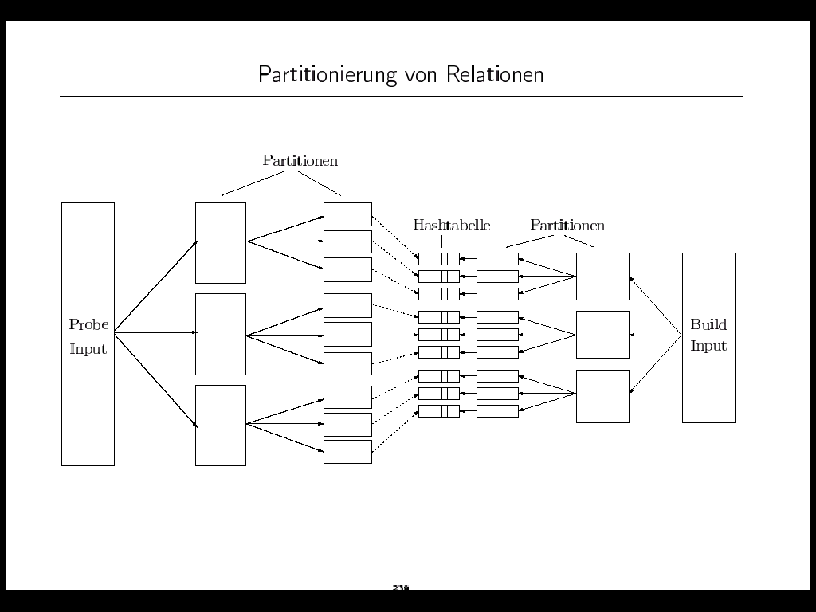

Slide 6
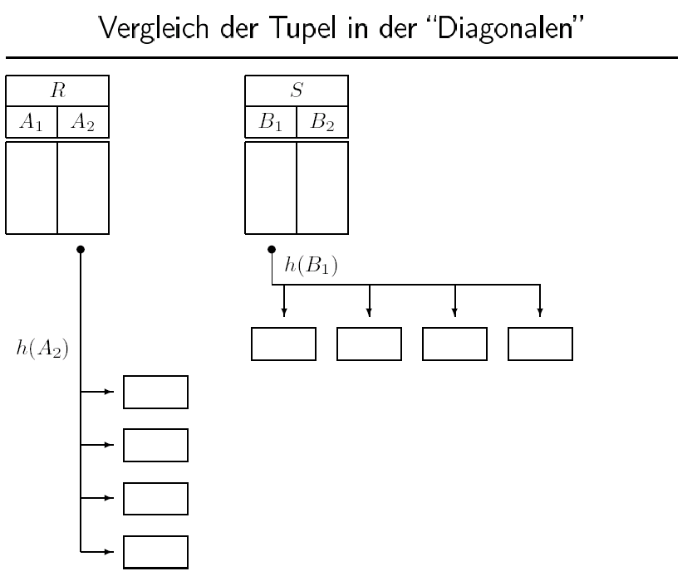

Slide 7
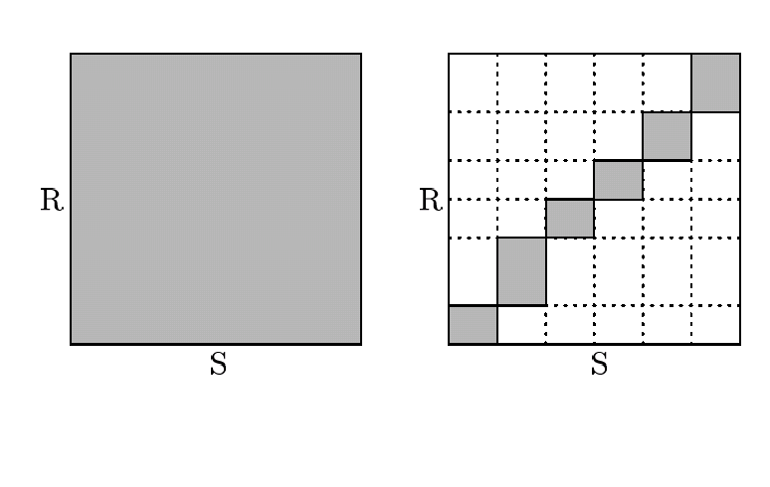

Slide 8
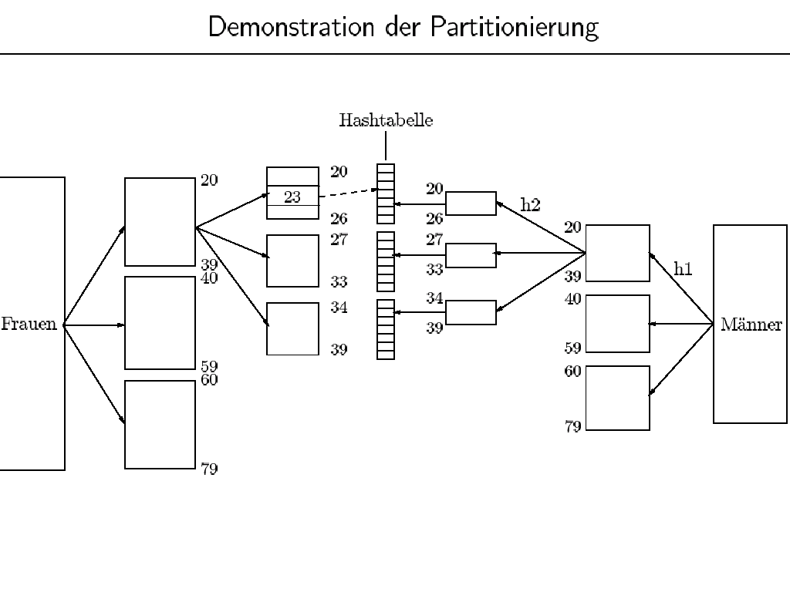

Slide 9
Mengendurchschnitt (~Join) mit einem Hash/Partitionierungs-Algorithmus
R ∩ S
R
2
3
44
5
76
90
13
17
42
88
S
44
17
97
4
6
27
2
13
3
Nested Loop: O(N²)
Sortieren: O(N log N)
Partitionieren und Hashing

Slide 10
Mengendurchschnitt mit einem Hash/Partitionierungs-Algorithmus
R ∩ S
R
2
3
44
5
76
90
13
17
42
88
R
3
90
42
76
13
88
2
44
5
17
S
44
17
97
4
6
27
2
13
3
Mod 3

Slide 11
Mengendurchschnitt mit einem Hash/Partitionierungs-Algorithmus
R ∩ S
R
2
3
44
5
76
90
13
17
42
88
R
3
90
42
76
13
88
2
44
5
17
S
6
27
3
97
4
13
44
17
2
S
44
17
97
4
6
27
2
13
3
Mod 3
Mod 3

Slide 12
Mengendurchschnitt mit einem Hash/Partitionierungs-Algorithmus
R ∩ S
R
2
3
44
5
76
90
13
17
42
88
R
3
90
42
76
13
88
2
44
5
17
S
6
27
3
97
4
13
44
17
2
S
44
17
97
4
6
27
2
13
3
Mod 3
Mod 3

Slide 13
Mengendurchschnitt mit einem Hash/Partitionierungs-Algorithmus
R ∩ S
Hashtabelle
R
3
90
42
76
13
88
2
44
5
17
S
6
27
3
97
4
13
44
17
2
Mod 5
6
27
3
Build-
Phase

Slide 14
Mengendurchschnitt mit einem Hash/Partitionierungs-Algorithmus
R
3
90
42
76
13
88
2
44
5
17
R ∩ S = {3, }
S
6
27
3
97
4
13
44
17
2
Mod 5
6
27
3
Probe-
Phase

Slide 15
Mengendurchschnitt mit einem Hash/Partitionierungs-Algorithmus
R
3
90
42
76
13
88
2
44
5
17
R ∩ S = {3, }
S
6
27
3
97
4
13
44
17
2
Mod 5
97
13
4
Build-Phase
2. Partition

Slide 16
Mengendurchschnitt mit einem Hash/Partitionierungs-Algorithmus
R
3
90
42
76
13
88
2
44
5
17
R ∩ S = {3, }
S
6
27
3
97
4
13
44
17
2
Mod 5
97
13
4
Probe-Phase
2. Partition

Slide 17
Mengendurchschnitt mit einem Hash/Partitionierungs-Algorithmus
R
3
90
42
76
13
88
2
44
5
17
R ∩ S = {3, 13 }
S
6
27
3
97
4
13
44
17
2
Mod 5
97
13
4
Probe-Phase
2. Partition

Slide 18
Mengendurchschnitt mit einem Hash/Partitionierungs-Algorithmus
R ∩ S = {3, 13, 2, 44, 17 }
R
2
3
44
5
76
90
13
17
42
88
R
3
90
42
76
13
88
2
44
5
17
S
6
27
3
97
4
13
44
17
2
S
44
17
97
4
6
27
2
13
3
Mod 3
Mod 3

Slide 19
Vergleich: Sort/Merge-Join versus Hash-Join
R
S
run
run
merge
merge
R
S
partition
partition

Slide 20
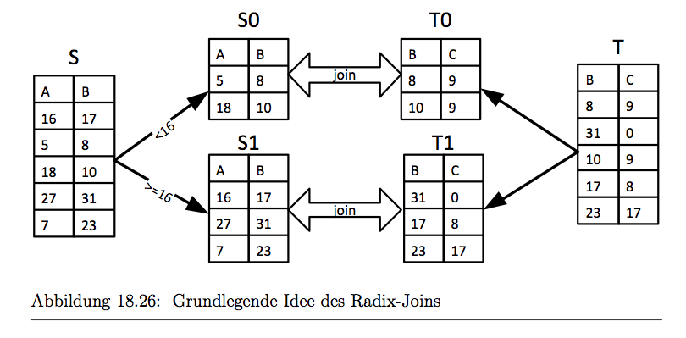
Radix-Join: Erhöhung der Cache-Lokalität durch Partitionierung

Slide 21
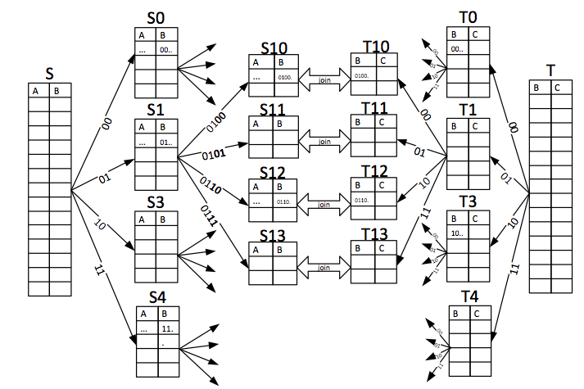
Wiederholte Partitionierung

Slide 22
Range partitioning of private input
histogram of
worker W₁
prefix sum of
worker W₁
19=10011
19
19
9
<16
W₁
7 = 00111
4
0
7
≥16
→1
chunk of worker W₁
3
0
3
21
21
17 = 10001
2
1
W₂
17
17
2=00010
histogram of
worker W₂
prefix sum of
worker W₂
2
19
23
W₁
23
<16
→5
3
4
4
≥16
chunk of worker W₂
4
3
31
31
8
W₂
20
20
26
26
Notes:
Let me show you how it works using this example. There are two workers, each of them has a private input chunk of size 7. The key domain is from 0 to 31. We need to create two partitions so we take the first bit of the key to decide to which partition to scatter a tuple. This results in all keys smaller than 16 to be placed in the first partition and all keys between 16 and 31 in the second.
Instead of just copying the tuples to their new partition which would incur synchronization overhead, we precompute the target positions of the tuples. In a first pass through the data each thread computes a histogram stating how many of its tuples fall into which partition. Here again we use the first bit of each key as an index into the histogram. In our example four tuples of the first chunk fall into the first partition and three in to the second. From the second chunk three tuples belong to the first target partition and four to the second. Out of these histograms, each thread then computes prefix sums which denote the starting addresses within the target partitions. In our example, worker W1 begins writing at position 0 within the first and the second target partition. Worker W2 starts writing at position 4 within the first target partition as worker W1 scatters 4 tuples to this partition. Within the second partition, workers W2 begins writing at position 3 because the first three positions belong to worker W1.
This way, the two workers write to distinct positions within the target partitions and don‘t require any kind of synchronization. Each worker scatters its tuples according to its prefix sum and updates its prefix sum accordingly.
For example, the first tuple with key 19 belongs to the second partition. Workers W1 checks the second bucket of its prefix sum, updates the position and writes the tuple to the first position of the second partition. After all tuples have been scattered, the result looks like this.

Slide 23
Range partitioning of private input
histogram of
worker W₁
prefix sum of
worker W₁
19=10011
19
9
9
<16
W₁
7
7 = 00111
4
0
7
≥16
→1
3
chunk of worker W₁
3
0
3
1
21
17 = 10001
2
1
W₂
4
17
8
2=00010
histogram of
worker W₂
prefix sum of
worker W₂
2
19
23
W₁
21
<16
→5
3
4
4
≥16
17
chunk of worker W₂
4
3
31
23
8
W₂
31
20
20
26
26
Notes:
Radix partitioning bears some risks in case of skew. For uniform data, it is ok to use static partition bounds like we did it in the example. But if the data is skewed, this can result in totally different chunk sizes and thus unbalanced loads of the threads.

Slide 24
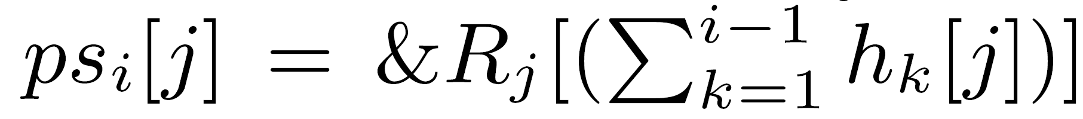
Real C hacker at work …

Slide 25
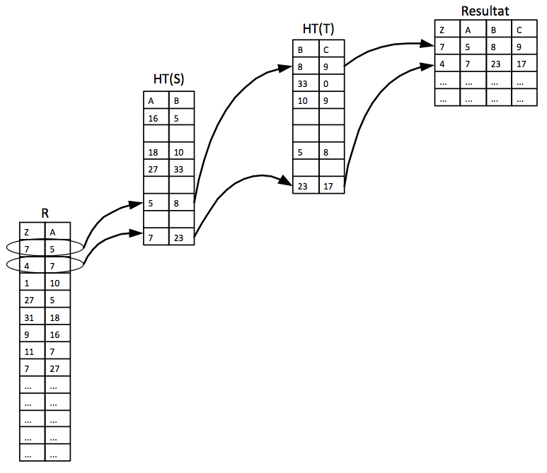
Paralleler Hash-Join ohne Partitionierung

